Slide 1
Data extraction
Data extraction is the process of collecting or retrieving disparate types of data from a variety of sources, many of which may be poorly organized or completely unstructured. Data extraction makes it possible to consolidate, process, and refine data so that it can be stored in a centralized location in order to be transformed. These locations may be on-site, cloud-based, or a hybrid of the two.

Slide 2
Why data extraction is important
The extraction of data is linked to assessment of study quality in that both processes are often undertaken at the same time. Standardised data extraction forms can provide consistency in a systematic review, whilst reducing bias and improving validity and reliability.

Slide 3
What are the steps in the ETL process
There are three steps in the ETL process:
Extraction: Data is taken from one or more sources or systems. The extraction locates and identifies relevant data, then prepares it for processing or transformation. Extraction allows many different kinds of data to be combined and ultimately mined for business intelligence.
Transformation: Once the data has been successfully extracted, it is ready to be refined. During the transformation phase, data is sorted, organized, and cleansed. For example, duplicate entries will be deleted, missing values removed or enriched, and audits will be performed to produce data that is reliable, consistent, and usable.
Loading: The transformed, high quality data is then delivered to a single, unified target location for storage and analysis.

Slide 4
Types of extractions
2 types of extractions
Full extraction
The first time you replicate any source you have to do a full extraction, and some data sources have no way to identify data that has been changed, so reloading a whole table may be the only way to get data from that source. Because full extraction involves high data transfer volumes, which can put a load on the network, it’s nIncremental extraction
Some data sources are unable to provide notification that an update has occurred, but they are able to identify which records have been modified and provide an extract of those records. During subsequent ETL steps, the data extraction code needs to identify and propagate changes. One drawback of incremental extraction is that it may not be able to detect deleted records in source data, because there’s no way to see a record that’s no longer there..

Slide 5
Difference between raw data and processed data
Raw data refers to data that have not been changed since acquisition
Editing, cleaning or modifying the raw data results in processed data.

Slide 6
What are the various stages of data processing cycle
Six stages of data processing
1. Data collection
Collecting data is the first step in data processing. Data is pulled from available sources, including data lakes and data warehouses. It is important that the data sources available are trustworthy and well-built so the data collected (and later used as information) is of the highest possible quality.
Data preparation
Once the data is collected, it then enters the data preparation stage. Data preparation, often referred to as “pre-processing” is the stage at which raw data is cleaned up and organized for the following stage of data processing. During preparation, raw data is diligently checked for any errors. The purpose of this step is to eliminate bad data (redundant, incomplete, or incorrect data) and begin to create high-quality data for the best business intelligence.

Slide 7
Data input
The clean data is then entered into its destination (perhaps a CRM like Salesforce or a data warehouse like Redshift), and translated into a language that it can understand. Data input is the first stage in which raw data begins to take the form of usable information.
4. Processing
During this stage, the data inputted to the computer in the previous stage is actually processed for interpretation. Processing is done using machine learning algorithms, though the process itself may vary slightly depending on the source of data being processed (data lakes, social networks, connected devices etc.) and its intended use (examining advertising patterns, medical diagnosis from connected devices, determining customer needs, etc.).
5. Data output/interpretation
The output/interpretation stage is the stage at which data is finally usable to non-data scientists. It is translated, readable, and often in the form of graphs, videos, images, plain text, etc.). Members of the company or institution can now begin to self-serve the data for their own data analytics projects.

Slide 8
6. Data storage
The final stage of data processing is storage. After all of the data is processed, it is then stored for future use. While some information may be put to use immediately, much of it will serve a purpose later on. Plus, properly stored data is a necessity for compliance with data protection legislation like GDPR. When data is properly stored, it can be quickly and easily accessed by members of the organization when needed.

Slide 9
What is CRISP
The CRoss Industry Standard Process for Data Mining (CRISP-DM) is a process model with six phases that naturally describes the data science life cycle. It’s like a set of guardrails to help you plan, organize, and implement your data science (or machine learning) project.
Business understanding
data understanding
Data preparation
Modeling
Evaluation
Deployment

Slide 10
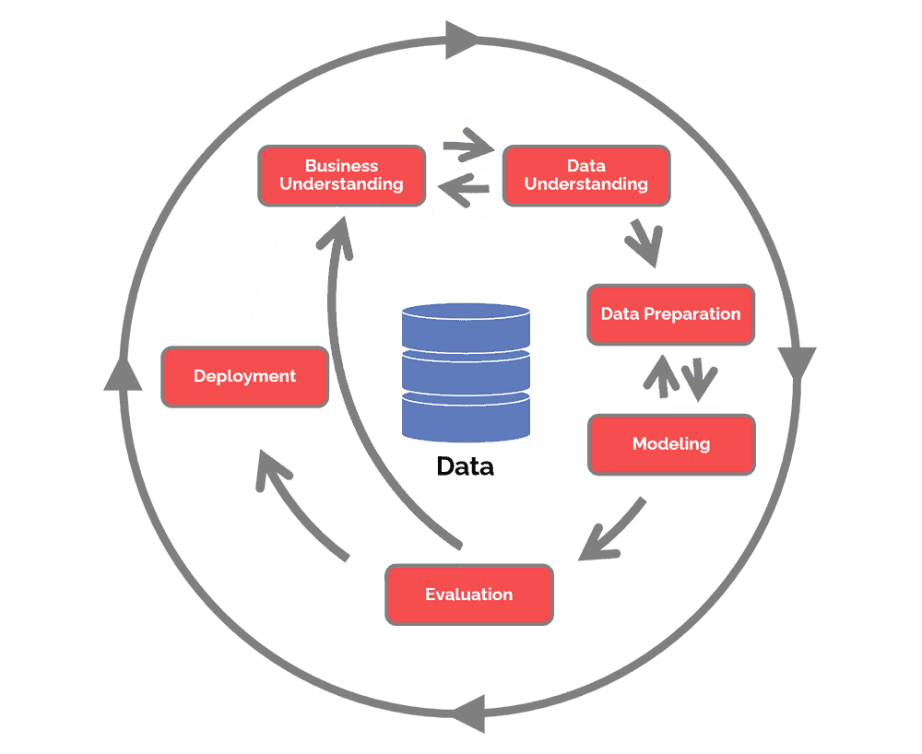

Slide 11
I. Business Understanding
Any good project starts with a deep understanding of the customer’s needs. Data mining projects are no exception and CRISP-DM recognizes this.
The Business Understanding phase focuses on understanding the objectives and requirements of the project. Aside from the third task, the three other tasks in this phase are foundational project management activities that are universal to most projects:
Determine business objectives: You should first “thoroughly understand, from a business perspective, what the customer really wants to accomplish.” (CRISP-DM Guide) and then define business success criteria.
Assess situation: Determine resources availability, project requirements, assess risks and contingencies, and conduct a cost-benefit analysis.
Determine data mining goals: In addition to defining the business objectives, you should also define what success looks like from a technical data mining perspective.
Produce project plan: Select technologies and tools and define detailed plans for each project phase.
While many teams hurry through this phase, establishing a strong business understanding is like building the foundation of a house – absolutely essential.

Slide 12
Data Understanding
Next is the Data Understanding phase. Adding to the foundation of Business Understanding, it drives the focus to identify, collect, and analyze the data sets that can help you accomplish the project goals. This phase also has four tasks:
Collect initial data: Acquire the necessary data and (if necessary) load it into your analysis tool.
Describe data: Examine the data and document its surface properties like data format, number of records, or field identities.
Explore data: Dig deeper into the data. Query it, visualize it, and identify relationships among the data.
Verify data quality: How clean/dirty is the data? Document any quality issues.

Slide 13
Data Preparation
A common rule of thumb is that 80% of the project is data preparation.
This phase, which is often referred to as “data munging”, prepares the final data set(s) for modeling. It has five tasks:
Select data: Determine which data sets will be used and document reasons for inclusion/exclusion.
Clean data: Often this is the lengthiest task. Without it, you’ll likely fall victim to garbage-in, garbage-out. A common practice during this task is to correct, impute, or remove erroneous values.
Construct data: Derive new attributes that will be helpful. For example, derive someone’s body mass index from height and weight fields.
Integrate data: Create new data sets by combining data from multiple sources.
Format data: Re-format data as necessary. For example, you might convert string values that store numbers to numeric values so that you can perform mathematical operations.

Slide 14
Modeling
What is widely regarded as data science’s most exciting work is also often the shortest phase of the project.
Here you’ll likely build and assess various models based on several different modeling techniques. This phase has four tasks:
Select modeling techniques: Determine which algorithms to try (e.g. regression, neural net).
Generate test design: Pending your modeling approach, you might need to split the data into training, test, and validation sets.
Build model: As glamorous as this might sound, this might just be executing a few lines of code like “reg = LinearRegression().fit(X, y)”.
Assess model: Generally, multiple models are competing against each other, and the data scientist needs to interpret the model results based on domain knowledge, the pre-defined success criteria, and the test design.
Although the CRISP-DM guide suggests to “iterate model building and assessment until you strongly believe that you have found the best model(s)”, in practice teams should continue iterating until they find a “good enough” model, proceed through the CRISP-DM lifecycle, then further improve the model in future iterations.

Slide 15
Evaluation
Whereas the Assess Model task of the Modeling phase focuses on technical model assessment, the Evaluation phase looks more broadly at which model best meets the business and what to do next. This phase has three tasks:
Evaluate results: Do the models meet the business success criteria? Which one(s) should we approve for the business?
Review process: Review the work accomplished. Was anything overlooked? Were all steps properly executed? Summarize findings and correct anything if needed.
Determine next steps: Based on the previous three tasks, determine whether to proceed to deployment, iterate further, or initiate new projects.

Slide 16
Deployment
“Depending on the requirements, the deployment phase can be as simple as generating a report or as complex as implementing a repeatable data mining process across the enterprise.”
–CRISP-DM Guide
A model is not particularly useful unless the customer can access its results. The complexity of this phase varies widely. This final phase has four tasks:
Plan deployment: Develop and document a plan for deploying the model.
Plan monitoring and maintenance: Develop a thorough monitoring and maintenance plan to avoid issues during the operational phase (or post-project phase) of a model.
Produce final report: The project team documents a summary of the project which might include a final presentation of data mining results.
Review project: Conduct a project retrospective about what went well, what could have been better, and how to improve in the future.
Your organization’s work might not end there. As a project framework, CRISP-DM does not outline what to do after the project (also known as “operations”). But if the model is going to production, be sure you maintain the model in production. Constant monitoring and occasional model tuning is often required.

